Slide 1
Cloud Computing and Cloud Networking
Winter 2025
K. K. Ramakrishnan
kk@cs.ucr.edu
SSC 308
Tue-Thur 2:00 pm - 3:20 pm

Slide 2
Today’s Lecture
Administrative matters
Course Overview
topics we expect to cover
Introduction to Cloud Computing

Slide 3
Class Structure
Tuesday, Thursday: 2:00 pm – 3:20 pm
Lecture format
Slides (posted on eLearn), Papers (will be referred to in slides)
Please read the papers to get in-depth understanding
Strongly encourage to read the papers, please
Interactive (I really encourage questions, comments)
No question is ‘too simple’ – if you have a question, likely others have similar question in their mind too.
Contacts:
Instructor: K. K. Ramakrishnan (email: kk@cs.ucr.edu)
Email: (will read and respond to emails on Tue & Thur: before the end of the night, whenever possible)
Office Hours: Tuesday, 4:00 pm – 5:00 pm
Teaching Assistant: Hongmiao Yu (hyu125@ucr.edu)
Office Hours: <Answer Hongmiao’s poll for suitable time>

Slide 4
Course Readings
Textbook (will only be used (very sparingly) for introductory material)
“Distributed and Cloud Computing – From Parallel Processing to the Internet of Things”, by Kai Hwang, Geoffrey Fox and Jack Dongorra, Published by Morgan Kaufmann.
The class will be focused on topics taken from papers on cloud computing and cloud networking
Main material will be from slides – extracted from papers
Will contain references to the papers that students are responsible for reading for complete understanding
Some may be distributed online (eLearn.ucr.edu)
Those papers and standards documents are required reading

Slide 5
Course Grading
4-5 Homeworks (15% of grade)
Get familiar with CloudLab concepts in the first few weeks @ beginning of the course – will help for project work
One mid-term Exam, Feb. 6, 2023 (25% of grade)
Final Exam, March 13, 2023 (30% of grade) (in class)
Projects: Student Selected Project (30% of grade)
Proposal – 1 page; discuss with instructor – week 2,3.
Presentation of Project proposal, Outline of Approach – Week 4,5 (2 students per group; 5 minute presentation)
Final Project Demo, Report – ‘final exam day’ (Thursday, March 20, 7:00 pm - 10:00 pm)
Each student group (at most 2 students in each group) presents for 20 minutes, introducing problem, detailing solution and demonstrating that its working.
Use CloudLab for Project

Slide 6
Syllabus for CS 208, Winter 2025
Introduction to Cloud Computing
Virtualization: OS Virtualization, Hardware support, Memory Management
VMs-Different Hypervisors; Linux and Docker Containers; Comparison
Networking the Cloud: VM Replication and Migration, Speculative Execution
Failure Resilience and Disaster Resilience with Cloud Computing
Containers and CNI Deep Dive; Challenges with Container Migration
Orchestration: OpenStack; Borg/Kubernetes
Data Center Networks Overview
Software Defined Networking, OpenFlow and Programmable Networks
Remote Direct Memory Access (RDMA)
Serverless Computing, Serving ML Workloads
As a way of encouraging you to attend, I will provide a 5% EXTRA CREDIT when you attend all the classes.

Slide 7
Evolution of Computing and Communication Systems
We have seen over the last several decades, the evolution of computing, storage and networking capabilities
Each step in the evolution caused by changes in the relative speed or cost of computing, storage and communications
Caused/Allowed processing and storage to be closer or farther from each other and from users
E.g., moved from mainframes to mini-computers to workstations and PCs as computing costs and capabilities evolved relative to I/O
Then moved to client-server and eventually to web based services as networking capabilities evolved
Cloud computing is taking advantage of current balance in cost, performance and capability of computing vs. communications

Slide 8
From Desktop/HPC/Grids to Internet Clouds in 30 Years
HPC moving from centralized supercomputers to geographically distributed desktops, desksides, clusters, and grids to clouds over the last 30 years
R/D efforts on HPC, clusters, Grids, P2P, and virtual machines has laid the foundation of cloud computing that has been greatly advanced since 2007
Location of computing infrastructure in areas with lower costs in hardware, software, datasets, space, and power requirements – moving from desktop computing to datacenter-based clouds

Slide 10
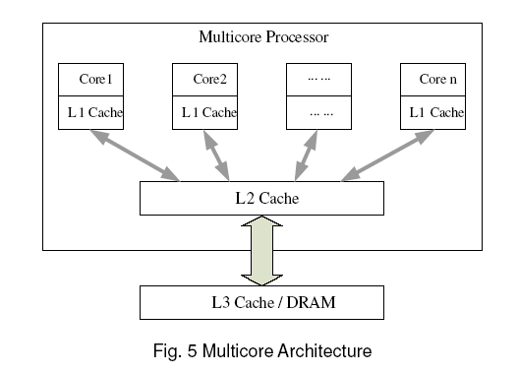

Slide 11
Storage capacity has increased, but access times are not keeping up.

Slide 12
Astonishing Cloud Computing Statistics
The global public cloud computing market revenue was $669.2 billion in 2023, about double ($330 B) in 2020, per IDC
Software as a Service: 45%; Infrastructure as a Service: 19.9%
Compare: Global PC sales in 2023 ~$ 155 billion
Providing data access from anywhere is the top reason for cloud adoption.
Organizations’ average yearly cloud budget was $3.8 million in 2023, up from $2.2M in 2018.
More than 90% of organizations use the cloud
About a third of companies’ IT budget goes to cloud services.
Cloud infrastructure spending surpassed $270 billion in 2023 ($80B in 2018)
The US is the most significant public cloud market: spending $216 billion in 2023 ($124.6 billion in 2019)

Slide 13
Some more observations on Cloud Adoption
90% of companies are on the cloud
60% of workloads are running on a hosted cloud service in 2019 (45% of workloads in 2018).
Amazon Web Services is the leading cloud vendor with a 32% share
When it was launched in 2006, AWS provided only one service. Now the company offers more than 140 services to its clients.
The average business runs 38% of workloads in public and 41% in private cloud.
Hybrid cloud adoption is at 58%
Privacy, security and lack of staff training are the top roadblocks to cloud adoption.

Slide 14



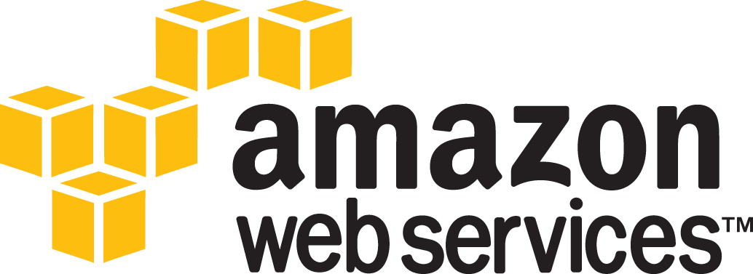




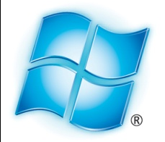
What is the cloud?
Remotely available
Pay-as-you-go
High scalability
Shared infrastructure
Azure
Notes:
What is the cloud?
Difficult question to answer .... trying to sell themselves as offering cloud based services. But have traits in common
First, cloud companies offer remotely available services. So they are providing you with some software or set of resources and you connect to those resources over the network.
Next, most cloud services rely on a pay-as-you-go model. This means that you are only paying for what you are actively using.
Finally, cloud services are really based around the idea of high scalability, and the reason they are able to scale up so much is that they are using a shared infrastructure for many different clients.

Slide 15
What is Cloud Computing?
A style of computing where scalable and elastic IT-enabled capabilities are delivered as a service to external customers using Internet technologies. (Gartner)
Cloud computing is a model for enabling convenient, on-demand network access to a shared pool of configurable computing resources (e.g., networks, servers, storage, applications, and services) that can be rapidly provisioned and released with minimal management effort or service provider interaction. (NIST)
Cloud computing is on-demand access to virtualized IT resources that are housed outside of your own data center, shared by others, simple to use, paid for via subscription, and accessed over the Web. (Information Week)
Key characteristics: delivered as a service, on-demand, dynamically scalable, rapid elasticity, network access, shared resource pooling, virtualized, No capital costs, pay-as-you-go

Slide 16
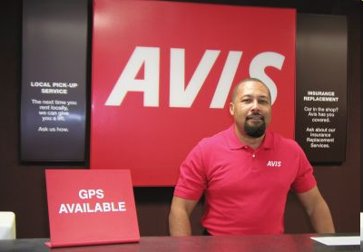
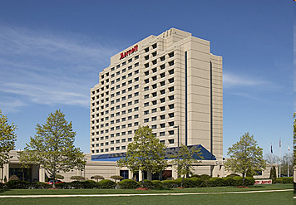
Many Familiar Aspects
The basic idea of on-demand, “pay as you go” services is common in everyday life.
Similarity to timesharing systems from the 1960s (except cheaper, more dynamic/elastic and agile).
Evolution for utility/on-demand computing.
Related to/evolution from grid computing.

Slide 17
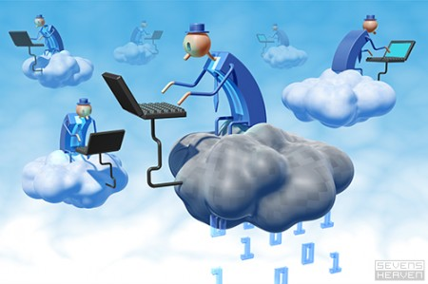
The Next Revolution in IT Cloud Computing
Classical Computing
Buy & Own
Hardware, System Software, Applications often to meet peak needs.
Install, Configure, Test, Verify, Evaluate
Manage
..
Finally, use it
$$$$....$(High CapEx)
Cloud Computing
Subscribe
Use
$ - pay for what you use, based on QoS
Every 18 months?
(Courtesy of Raj Buyya, 2012)
Copyright © 2012, Elsevier Inc. All rights reserved.

Slide 18
Basic Concept of Internet - based Cloud Services

Slide 19



























‘Cloud’ services grouped in 3 categories
What is Purchased | Bus | Dev | Cons
Software as a Service Application that is run on a multi-tenant platform and delivered over the Internet | ✓ |  | ✓
Platform as a Service Service that provides platform to create and run applications | ✓ | ✓
Infrastructure as a Service Compute on demand (servers, storage, networking) using shared platform | ✓ | ✓
Enabler: virtualization Early service versions: private server virtualization, utility hosting & storage
Connect / UC
Brew
Mobile Apps / Vertically Integrated
Apple iPhone
Android
Apple iPhone
Simple DB
MEAP
Azure
EC2, S3
Notes:
SaaS – business applications provided from a shared multi-tenant platform to help manage capital and IT expense, fairly mature market, new dynamic: mobile applications that perform a function and can be discretely purchased, ex. Mobile banking, mobile couponing, (NOT AN EXTENSION OF A PACKAGED APPLICATION TO A MOBILE DEVICE)
Software providers (MSFT, Oracle, MacAfee, Symantec)
ISPs (Google)
Application Service providers (Salesforce.com, McAfee, RightNOW)
Hardware Vendors (Cisco WebEx)
Middleware Vendors (Citrix GoToMeeting)
PaaS – ex. MEAP, Force.com
Software providers (MSFT)
ISPs (Google, Amazon)
SaaS providers (Salesforce.com)
Device Vendors (Apple iPhone)
IaaS
ISPs (Amazon)
Hosting Services Providers (AT&T, Rackspace, Savvis, Terramark, Verizon Business)
Hardware Vendors (IBM)
Device Vendors (Apple iPhone)
(mt) = MediaTemple
ServePath – GoGrid cloud hosting
Rackspace – Cloud Files, Cloud Servers, Cloud Sites
LongJump – business application platform
Concur - Corporate travel and expense management
Workday - Human resources and payroll
Taleo - Talent management
Kenexa - Human resources
Omniture - Web analytics; online business optimization
DealerTrack - Sales and finance for automotive retail
Constant Contact - Email marketing
Vocus - Public relations; government relations
SuccessFactors - Employee performance management
NetSuite - Accounting, ERP, CRM
19

Slide 20


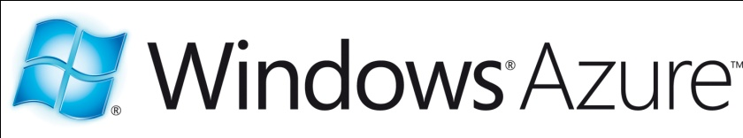
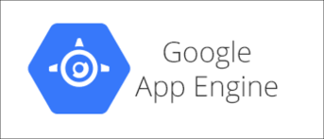
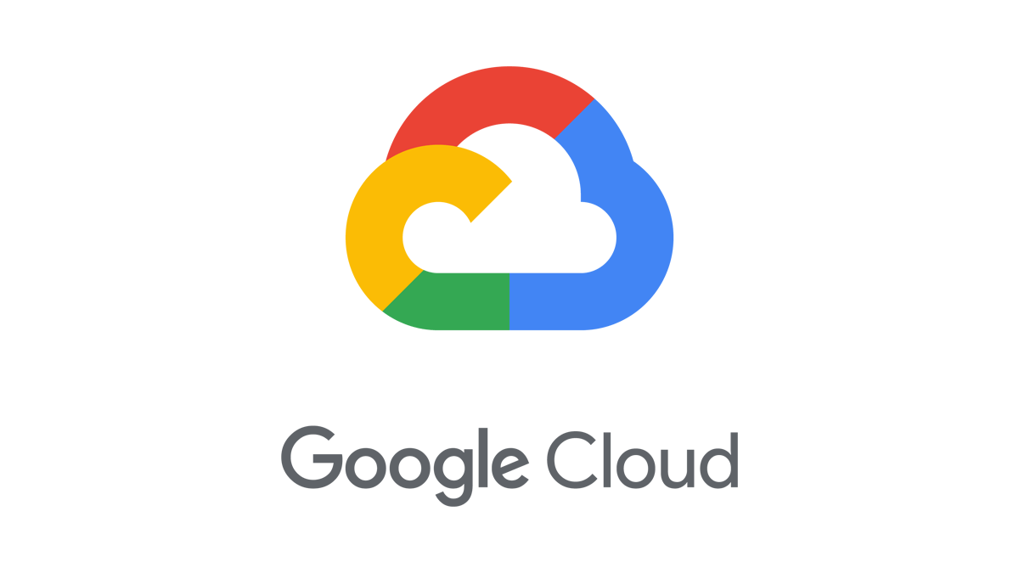
The Cloud Stack
Software as a Service
Hosted applications
Managed by provider
Office apps, CRM
Platform as a Service
Platform to let you run your own apps
Provider handles scalability
Azure
Software platforms
Infrastructure as a Service
Raw infrastructure
Can do whatever you want with it
Azure
Servers & storage
Notes:
We can sort these different cloud services into a stack of different categories. At the top we have the idea of software as a service. This is something like google’s email and office applications or Salesforce.com which offers a suite of web-based business applications. The idea here is that a company is providing a very specific piece of software, but they are able to do so at a much lower cost because they are offering their product to many different users. Next we have the Platform as a Service offerings like Google App Engine or MS Azure. Here the cloud company is letting you design your own applications and run it on their infrastructure. But to do that, you need to use the specific cloud API that they offer. At the bottom of the stack we have Infrastructure as a Service systems like Amazon’s Elastic Compute Cloud. These services give you complete control by allowing you to rent raw server and storage resources. Lower levels of the stack give the customer more control over what applications they want to run, but higher levels allow the cloud provider to build more automation into the system.

Slide 21

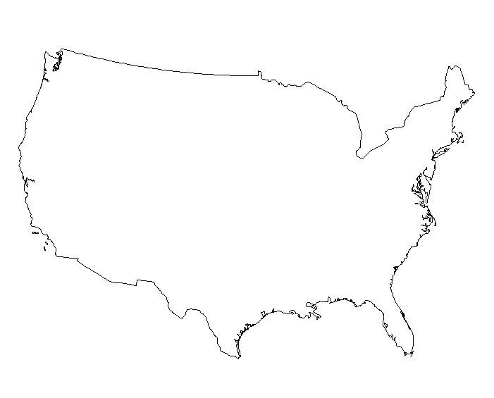


Cloud Computing
Rent computation and storage resources on demand
Fundamental Value Proposition:
Shared, dynamic allocation of resources
to reduce cost through multiplexing
Virtualization is a key component
Accessed by multiple enterprise sites
Cloud Platform types:
Software as a Service
Hotmail, Google Docs, Microsoft Office 365
Platform as a Service
Google App Engine, Microsoft Azure
Infrastructure as a Service
Amazon EC2, VMware vCloud, Google Cloud, Azure Cloud
Cloud Platform
Enterprise Sites

Slide 22
Server Virtualization
A layer of indirection between the software and the physical resources that it uses
e.g. CPU, Disk, Memory, and Network
Implementation details are hidden from the application
A flexible and programmable software layer called the Virtual Machine Monitor (VMM) or the hypervisor provides a mapping between the physical resources and the virtual resources
VMM allows the resources of a physical machine to be shared among multiple partitions known as virtual machines.
Notes:
VMM allows the resources of a physical machine to be shared among multiple partitions known as virtual machines.
Each virtual machine may run its own operating system and applications and is isolated from other virtual machines.

Slide 23
Server Virtualization
Virtual Machine 1
Virtual Machine n
Allows a server to be “sliced” into Virtual Machines
VM has own OS/applications + virtual resources
Rapidly adjust resource allocations
AppA
AppB
AppC
AppD
AppE
AppF
Guest Operating System
Guest Operating System
Virtual Resources
Virtual Resources
CPU
Disk
Memory
Net
CPU
Disk
Memory
Net
Virtual Machine Monitor (VMM)
CPU
Disk
Memory
Net
Physical Resources
Notes:
There are different types of virtualization e.g., storage virtualization and network virtualization. In this talk we will focus on machine virtualization.

Slide 24
Types of Virtualization
Applications
Applications
Applications
Guest OS
Non-
privileged
mode
Application
Guest OS
VMM
VMM
OS
Host OS
VMM
VMM (Hypervisor)
Host
OS
Privileged
mode
Hardware
Hardware
Hardware
Hardware
Physical
machine
Hosted VM
Native VM
Dual-Mode VM
Virtual machines can be built in multiple ways
1) With a VMM on top of the bare-metal, hypervisor is in privileged mode, mediates access to CPU, disk etc.
2) VMM runs on top of Host OS.
3) VM implemented in dual mode: Part of VMM in user mode, part in kernel (host OS needs modifications).

Slide 25
Primitive Operations in Virtual Machines:

Slide 26





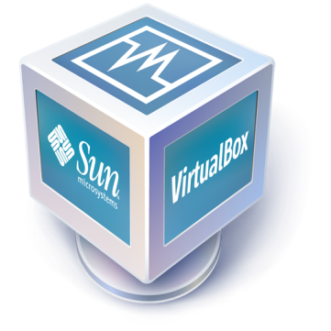

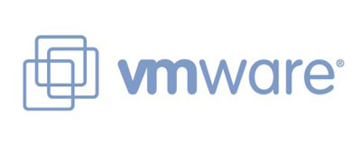

Server Virtualization
Allows a server to be “sliced” into Virtual Machines – multiple customers can share the server
- Basis for Cloud Providers
Native VM: VM has own OS/applications
Rapidly adjust resource allocations
VM migration within a LAN
VM 1
VM 2
Windows
Linux
Virtualization Layer
Windows
Windows
Notes:
An important piece of technology used by many clouds to allow multiple customers to share their servers is virtualization. Server virtualization is basically a way of splitting up a single physical server into multiple “virtual machines” or VMs. This allows you to....

Slide 27

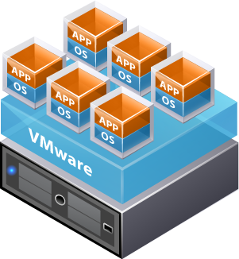
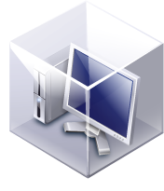
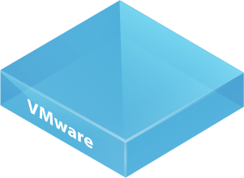

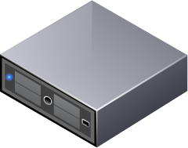

Virtualization: Useful in Data Centers
Virtual Servers
Consolidate servers
Faster deployment
Easier maintenance
Virtual Desktops
Host employee desktops in VMs
Remote access with thin clients
Desktop is available anywhere
Easier to manage and maintain
Work
Home

Slide 28

Enterprise Data Centers: Traditional Server Provisioning
Data center
Service A
Service B
Different set of servers for each service
Servers scale as the sum of “peak demands” of each service
Virtualization helps scale delivery infrastructure better

Slide 29
Enterprise Data Centers: Exploiting Virtualization
Data center
Common set of servers across all services
Servers scale as the “peak of the sum”
Transparent to users
No modification to services

Slide 30
Variability in Demand across services => Reduce Resource Requirements
If the peak workload of different services overlaps, the benefit of sharing same infrastructure diminishes
But with a variety of different services/workloads, multiplexing gains are typically achieved
there is a much reduced likelihood of peaks ‘lining up’
Resource requirements = F (peak of the sum)
Workload
Time

Slide 31
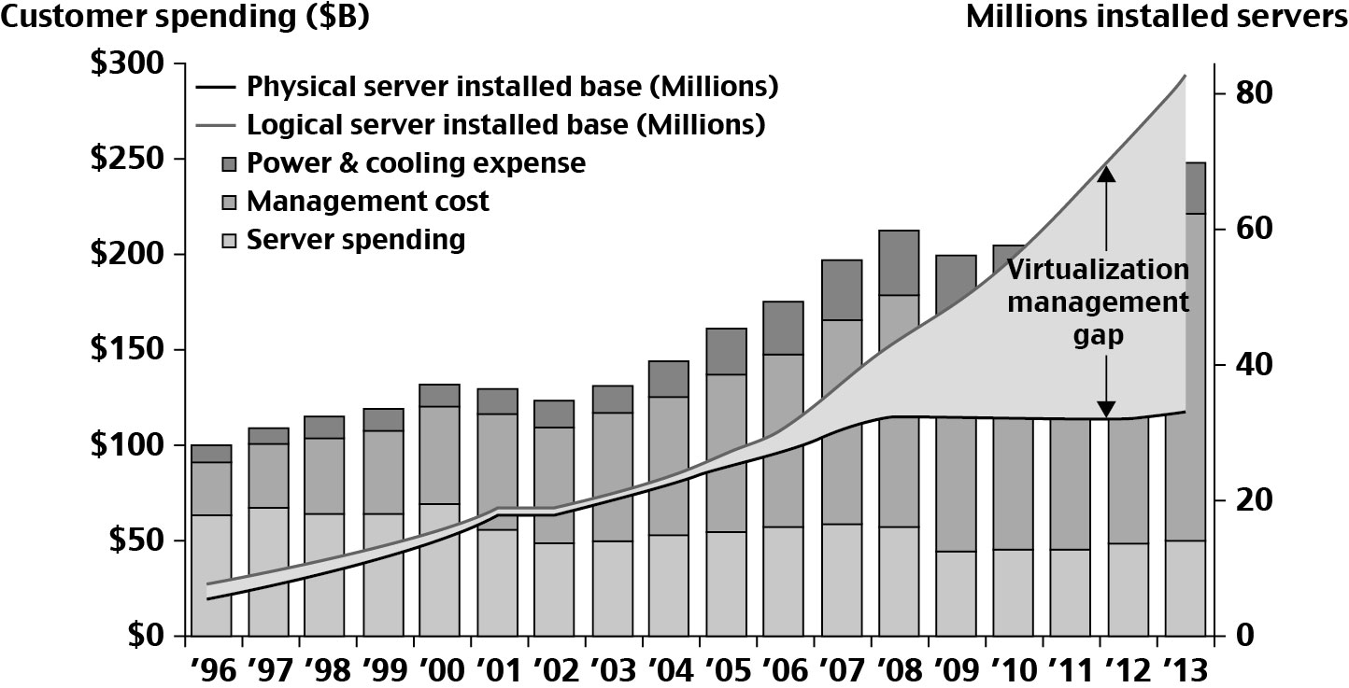
Datacenter and Server Cost Distribution

Slide 32
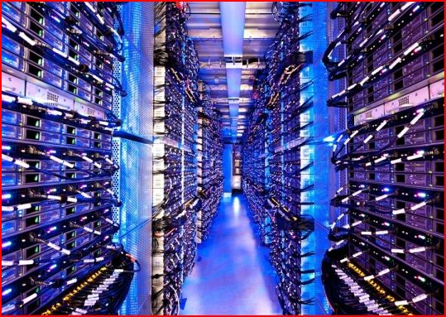

The Cloud
Historical roots in today’s Internet apps
Search, email, social networks
File storage (Live Mesh, Mobile Me, Flickr, …)
A cloud infrastructure provides a framework to manage scalable, reliable, on-demand access to applications
A cloud is the “invisible” backend to many of our mobile applications
A model of computation and data storage based on “pay as you go” access to “unlimited” remote data center capabilities
Copyright © 2012, Elsevier Inc. All rights reserved.

Slide 33
PaaS: Google App Engine
Provides highly scalable execution platform
Must write application to meet App Engine API
App Engine will autoscale your application
Strict requirements on application state
“Stateless” applications much easier to scale
Not based on virtualization
Multiple users’ threads running in same OS
Allows Google to quickly increase number of “worker threads” running each client’s application
Simple scalability, but limited control
Only supports Java and Python

Slide 34
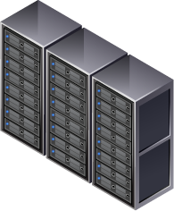
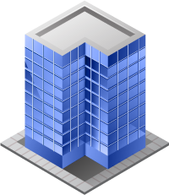
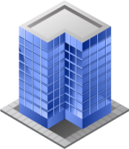
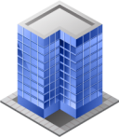


IaaS: Amazon EC2
Rents servers and storage to customers
Uses virtualization to share each server across multiple customers
Economy of scale lowers prices
Can create VM with push of a button
 | Smallest | Medium | Largest
VCPUs | 1 | 5 | 33.5
RAM | 613MB | 1.7GB | 68.4GB
Price | $0.02/hr | $0.17/hr | $2.10/hr
Storage | $0.10/GB per month
Bandwidth | $0.10 per GB

Slide 35
Cloud Deployments: Public, Private, Hybrid Clouds
Not all enterprises are comfortable with using public cloud services
Don’t want to share CPU cycles or disks with competitors
Privacy and regulatory concerns
Private Cloud
Use cloud computing concepts in a private data center
Automate VM management and deployment
Provides same convenience as public cloud
May have higher cost
Hybrid Model
Move resources between private and public depending on load

Slide 36
Deployment Models
Hybrid Cloud
Public Clouds
Private Cloud
Hybrid cloud:
Typically rely on company’s own resources, flex to public cloud resources at peak loads
Cost efficient
Can be made seamless (e.g., the same programming APIs in both clouds)

Slide 37
Cloud Computing Challenges: Deal with many issues (Courtesy of R. Buyya)
Pricing
Scalability
Virtualization
Resource Metering
Reliability
QoS
Billing
Service Level
Agreements
Energy Efficiency
Provisioning
on Demand
Utility & Risk Management
Security
Legal & Regulatory
(GDPR – Europe)
Privacy
Software Eng. Complexity
Trust
Programming Env. & Application Dev.

Slide 38

CS208 Cloud Computing and Cloud Networking
Instructor: Prof K. K. Ramakrishnan
TA: Sourav Panda

Slide 39
CS 208 Cloud Computing and Cloud Networking
TA: Sourav Panda
Office Hours: (Zoom link on elearn)
Email: spand009@ucr.edu
Register for Winter 2023 CS 208 class on piazza (https://piazza.com)
Homework to be done using CloudLab/Google Cloud
Projects can be done using CloudLab, Google Cloud, AWS or other approved platforms

Slide 40
Platform Access
CloudLab (mandatory) – registration deadline (Jan 13th 2023 11:59pm)
Sign up for account with school email at https://cloudlab.us/signup.php
Join KKProjects (then wait for approval)
These two videos provide a good introduction to Cloudlab:
Part 1: Creating a New Experiment in CloudLab and How to Extend an Experiment
https://www.youtube.com/watch?v=hHeLz5clsPc
Part 2: Managing your CloudLab Experiment Through the OpenStack Dashboard
https://www.youtube.com/watch?v=SZSYe8arwvs
AWS (optional)
Sign up for an account at https://aws.amazon.com/ (create free account) and follow the instructions
Notes:
Note that we do not have student credit so users should monitor their activities so they do not exceed the Free tier credit limit or access services not covered by the free tier credit limit.

Slide 41
Projects
Category | Title
Serverless platform comparison | Building and Deploying Mobile Serverless Application on Amazon AWS Lambda and Amazon EC2 Comparison of application deployment
 | Scheduling in Serverless Platforms Comparison of scheduling mechanisms on different platforms (scalability, warm/cold start latency)
Virtualization platform Analysis | Understanding KVM via some cloud-based application Use VM, Containers, Unikernel to host the application on KVM
 | Understanding Firecracker via some cloud-based application Use VM, Containers, Unikernel to host the application on KVM
Data Analysis | Apache Spark Streaming Analytics on Amazon EMR Analysis of twitter data
 | Analysis of Network Traffic Analysis of internet data

Slide 42
Projects
Category | Title
ML & GPU | On Device AI Offloading Offloading object detection from mobile to cloud
 | Distributed Deep Learning for Image Recognition Train single GPU tensor flow program on many GPUs faster
 | Understanding Openwhisk via a machine learning application Migrate handwritten Chinese character recognizer to serverless platform
 | Enabling GPUs in Serverless Computing for Scientific Domains Expose and manage GPU containers for scientific computing functions
Migration | Latency and Live Migration with IoT Evaluate migration performance of VMs with different latency
 | Distributed Decision Tree Implementation and Comparison Scale number of containers depending on latency/load

Slide 43
Examples of platforms used in projects
Cloudlab
Virtual machines
Physical servers
Virtualization platforms
KVM
Firecracker
XEN
Serverless platforms
Amazon Lambda
Nuclio
Knative
Openwhisk

Slide 44
Some Projects to think about
Container private cloud running on EC2 instances – use Kubernetes; OpenStack; Compare Openstack vs. Kubernetes
Use AWS or CloudLab to run ML libraries to learn and infer based on streaming data
Checkpoint and Migration for VMs (CloudLab); Containers (CloudLab)
Failure of VM on one machine and run on another (REMUS)
Failure of Container on one machine and run on another (CRIU)
MapReduce: Experiment with simple applications to evaluate performance characteristics. In-cast congestion problem solutions
Apache Spark/Storm streaming analytics
Compare Xen, KVM, Containers: performance of applications on each of these.
Use Amazon Lambda for Serverless Computing: Characterize impact of complete statelessness. Multiplexing advantage?

Slide 45
Some Projects to think about
Use Amazon for simple Machine Learning App for face recognition – done too many times in past 2 years.
Security: Enclaves, using Intel SGX (Everything You Should Know about Intel SGX Performance on Virtualized Systems)
SafeCode, SoftBound: use these to see if you can protect application from violating bounds
Microservices: web service formed of multiple microservices running on containers. Rather than 3 tiers, make it with 100 components.
Build consensus among multiple containers running a distributed application
Benchmarking Paxos libraries as more entities interact to achieve distributed consensus

Slide 46
Some Projects to think about
Google cloud trace: analysis of resource usage on cluster at Google and Microsoft to understand workloads. What % of servers are loaded? How many fewer servers can you run the whole trace on?
Similar task with Microsoft SOSP 2017– what analysis is feasible with released trace.
Setup NFV service chains. Different complexity. Use OpenNetVM
SDN projects. Use of P4
Offloading VR processing in the Cloud

